Slide 1
Financial Aid Presentation
Rachel Richards – Shippensburg University

Slide 2
COST OF ATTENDANCE
Each school has a different Cost of Attendance
Direct Costs
Tuition and Fees
Average Room and Board
Indirect Costs
Books and Supplies
Transportation Costs
Personal Expenses

Slide 3
COST OF ATTENDANCE
Examples:
HACC – off campus, full time: $20,670
SHIP – off campus, full time: $28,026
The COA is what you should PLAN for, not what you will actually pay to a university

Slide 4
Free Application for Federal Student Aid
FAFSA Opened October 1st - TODAY
FSA User ID and Password required
BOTH student AND parent need FSA User ID and password
Each email is applicant specific
Free to file
Do not pay a company or individual to file
Qualifies for Federal and State aid
Everyone can get a low interest student loan
File by May 1st for PA State Grant

Slide 5
FAFSA
Be diligent with data entry
Social Security Number, Date of Birth, Name
Email information
Both parent and student
Based on income, assets and household size
Amount in retirement accounts DO NOT count as an asset
Do not count worth of home in asset calculations
Can file with prior year income – 2018 for 20/21 year
File as early as October 1st, 2019 with 2018 tax data

Slide 6
New for 19/20

Slide 7
FAFSA – Estimated Family Contribution
EFC
Estimated or expected family contribution
Numeral qualifier to determine aid eligibility
Cost of Attendance minus EFC determines “need”
If EFC is higher than COA, student is considered ‘no need’

Slide 8
Examples
COA is $20,000; EFC is 0 = Child has a ‘need’ for $20,000 in aid
This student would qualify for federal PELL grant, state funding, institutional funds and Subsidized/Unsubsidized student loans
COA is $20,000; EFC is 9,000 = Child has a ‘need’ for $11,000 in aid
This student would qualify for state funding, institutional funds and Subsidized/Unsubsidized student loans
COA is $20,000; EFC is 25,000 = Child has NO NEED
This student would qualify for only a Unsubsidized loan

Slide 9
Types of Aid
Need based
Federal PELL grant
Federal Supplemental Educational Opportunity Grant (FSEOG)
PHEAA State Grant
Federal Work Study Positions
Subsidized Student Loans
No interest while student is attending
Non-need based
Unsubsidized Student Loans
Interest accrues for life of the loan from first disbursement

Slide 10
Sources of Aid
Federal Government
FAFSA
State Government
FAFSA and PHEAA application
Private Sources
Civic Organizations and Churches
Boys and Girl Scouts of America
Elks, Moose Clubs
Employers

Slide 11
Types of Aid
Scholarships
Money that does not have to be paid back
Awarded based on merit, skill or unique characteristic
Although student may meet criteria, still may not receive award due to funding limitations
Grants
Money that does not have to be paid back
Usually awarded based on financial need
Loans
Students and parents may borrow
Repayment normally begins after graduation
Only borrow what is needed
Look at loans as investment into the future
Employment
Work while attending college to assist with expenses

Slide 12
Needy Student Example
Zero EFC – full need, filed by May 1st for State Grant
Tuition, fees, room and meal plan = $25,000 billable
Full PELL grant, full PA State Grant, full federal loans = $15,000
Student will still have a ‘gap’ of $10,000 for the year

Slide 13
Filing the FAFSA
Who to file with
Biological or adopted parents ONLY
You file with the parent with whom you live
If you live with mom and dad , you file with both incomes
If you live with mom and she’s remarried to stepfather, you file with both mom and stepdad’s income
If you live with dad and he’s single, you file with only dad’s income
EFC is determined based on Income and Household Size
A single mother with 1 child making $100,000 a year will have higher EFC than a married couple with three children making the same income

Slide 14
Filing the FAFSA
If you do not live with a biological or adopted parent
Please call the Financial Aid office
Please speak to your high school guidance office
Please see me after presentation

Slide 15
Filing the FAFSA
20/21 FAFSA available October 1st, 2019
Will be qualified based on 2018 income
File early, link tax data with IRS
Since taxes should be complete by April, when you file in October, you can use the IRS Data Retrieval Tool (IRS DRT)
Ensures information is correct
Aid package from schools will be accurate

Slide 16
Filing the FAFSA
Can add up to 10 different school codes
As you are accepted to each University, they can award you an aid package if they have your FAFSA

Slide 17
PHEAA Application
Upon completion of the FAFSA, you will be prompted to complete the State Grant Application

Slide 18
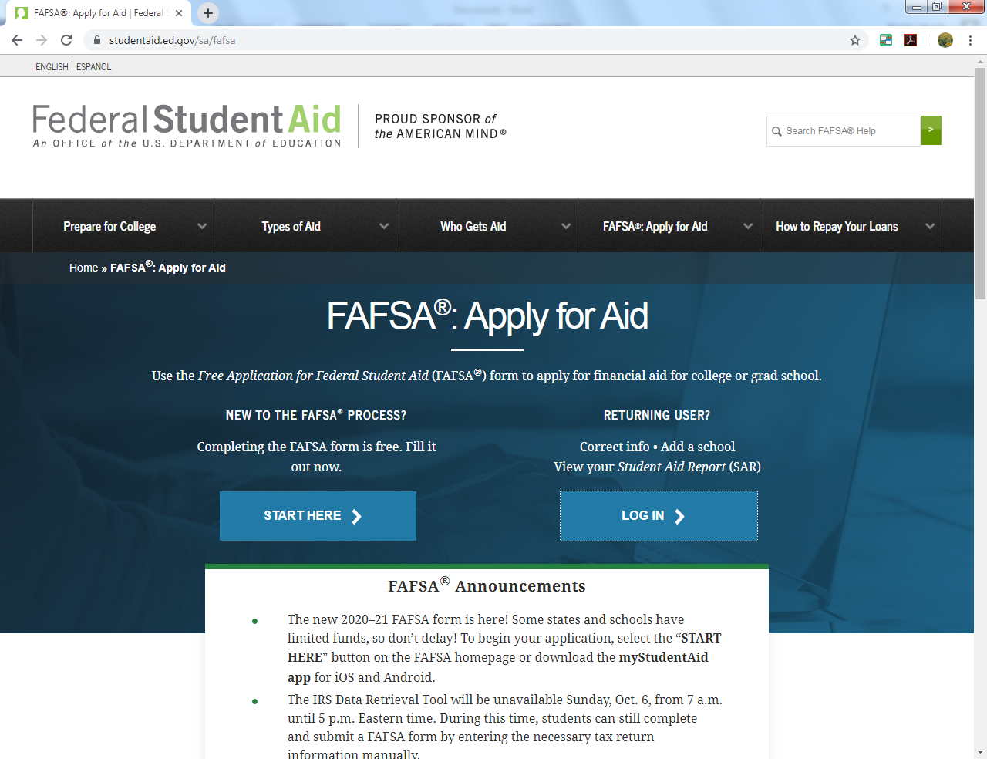

Slide 19
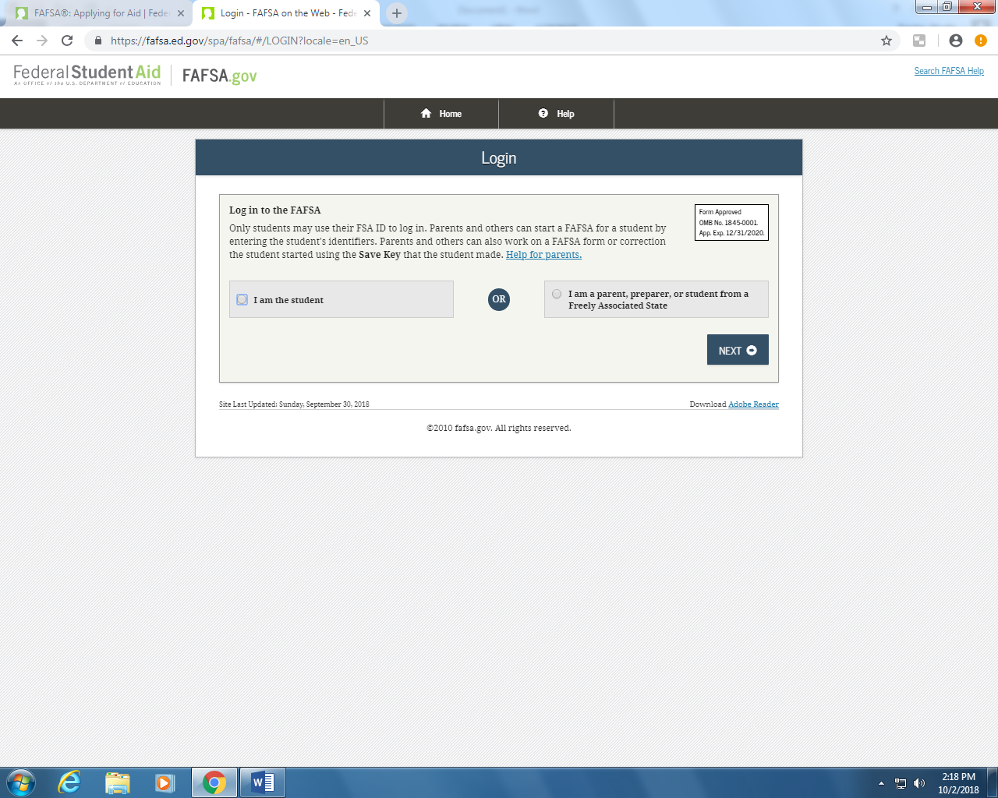

Slide 20
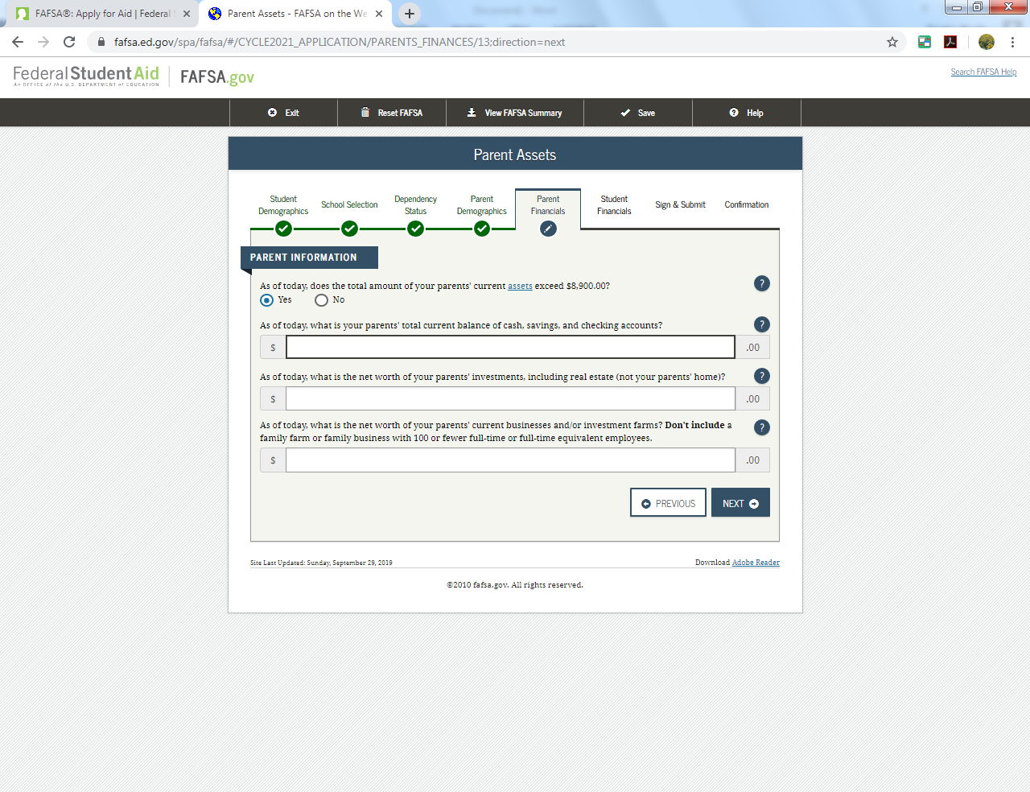

Slide 21
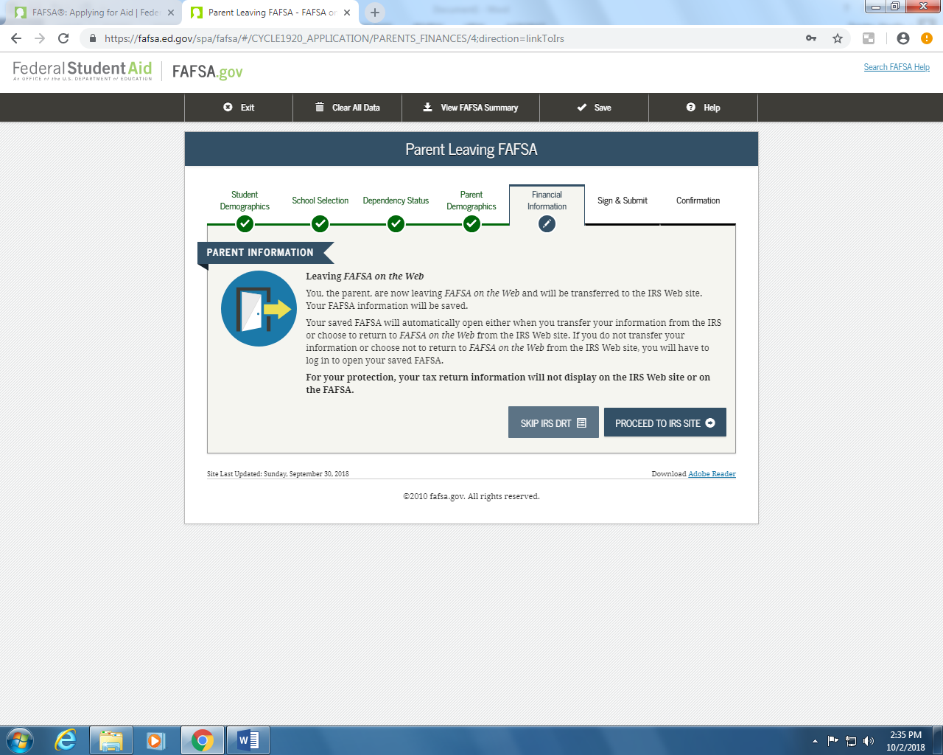

Slide 22
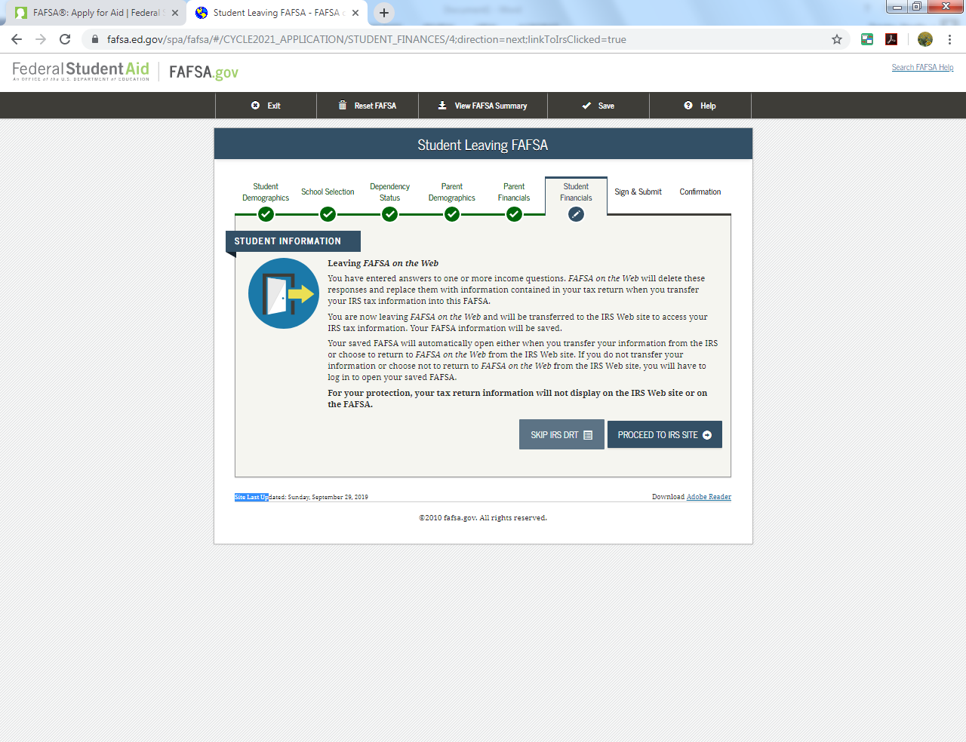

Slide 23
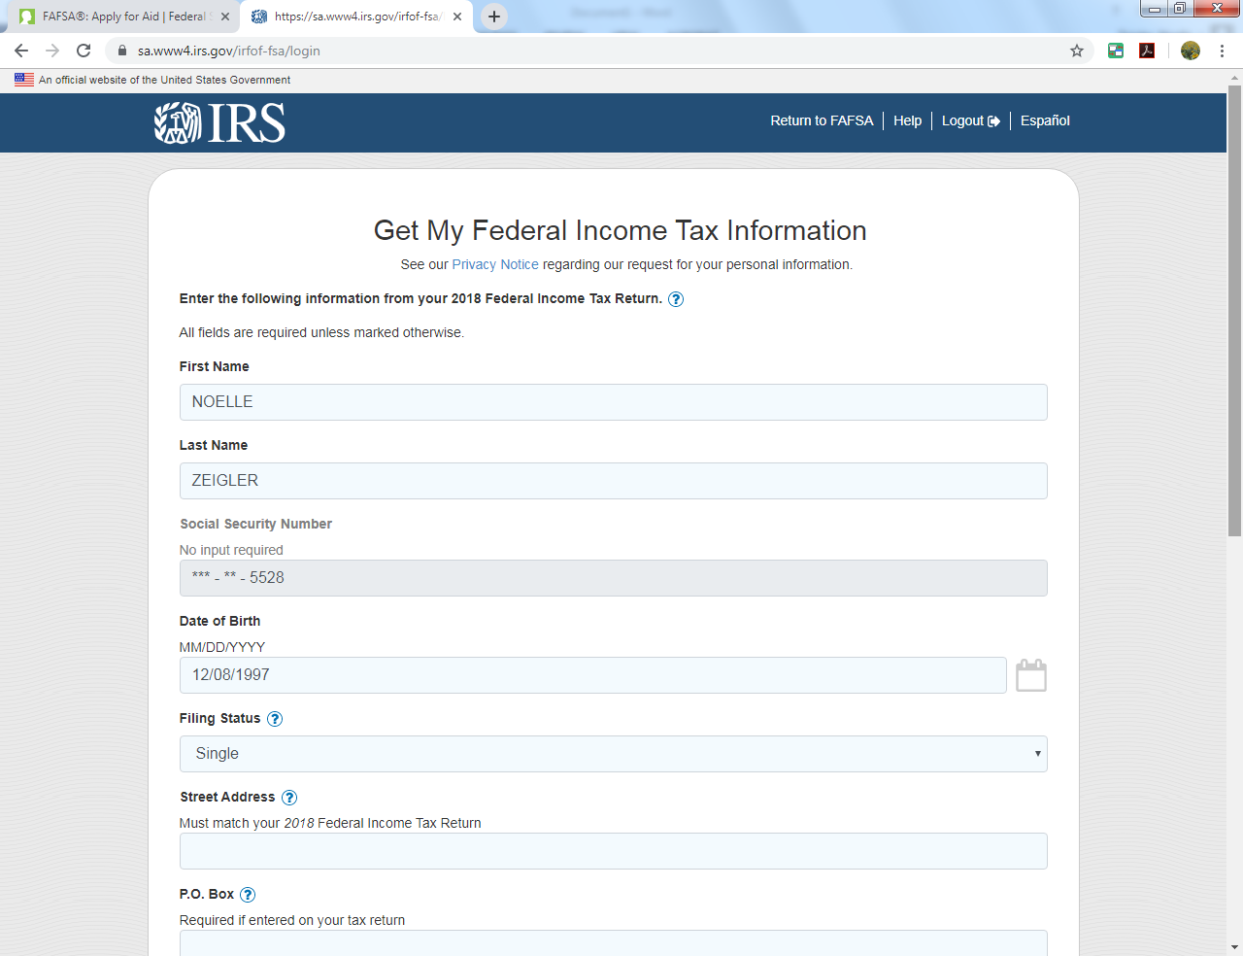

Slide 24
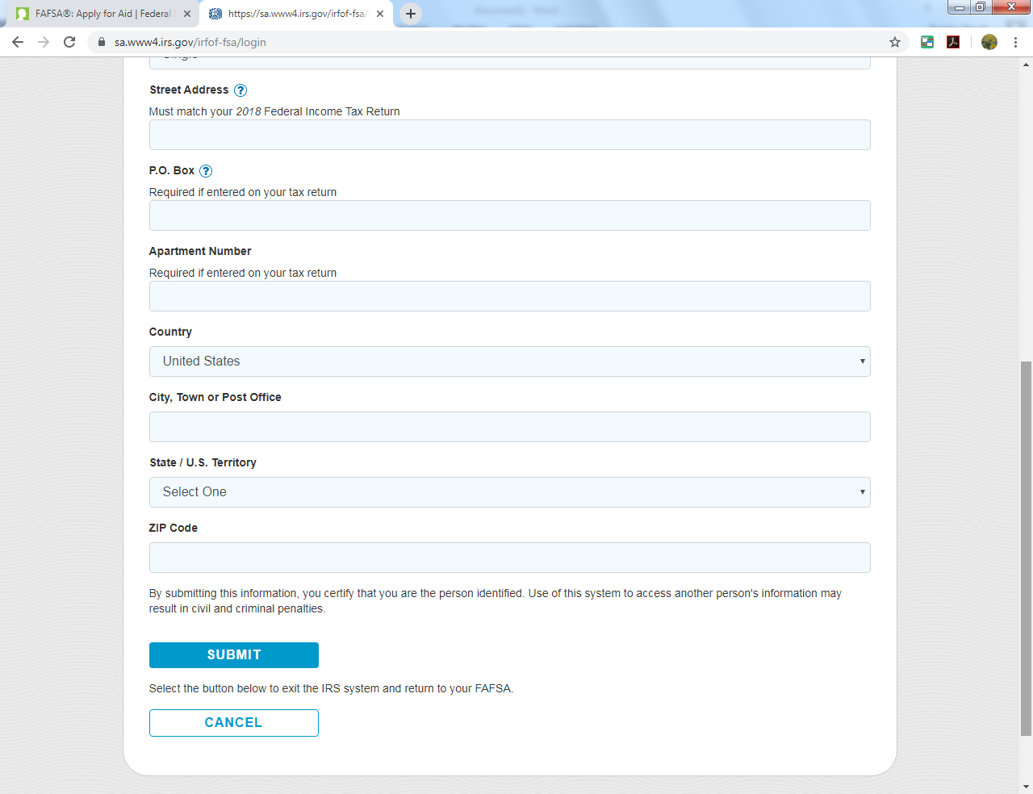

Slide 25
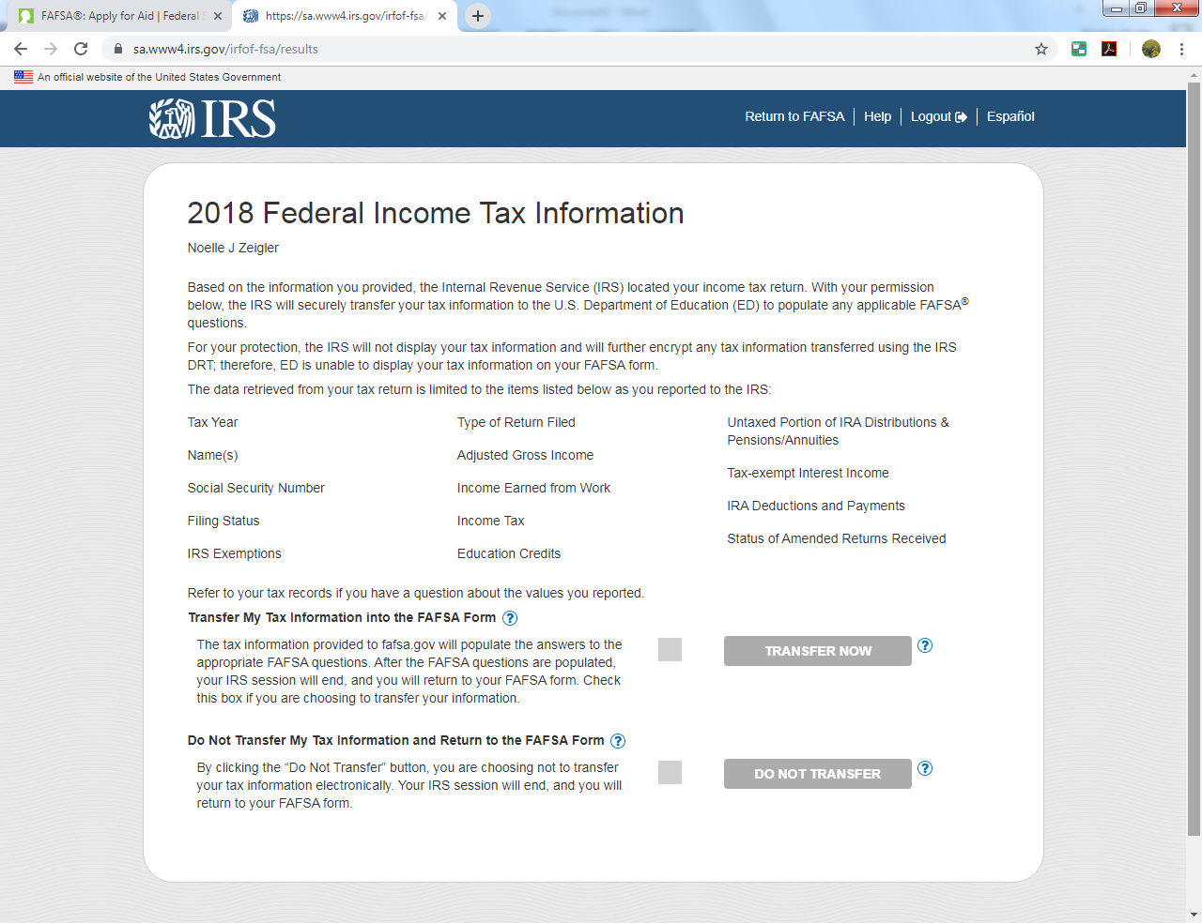

Slide 26
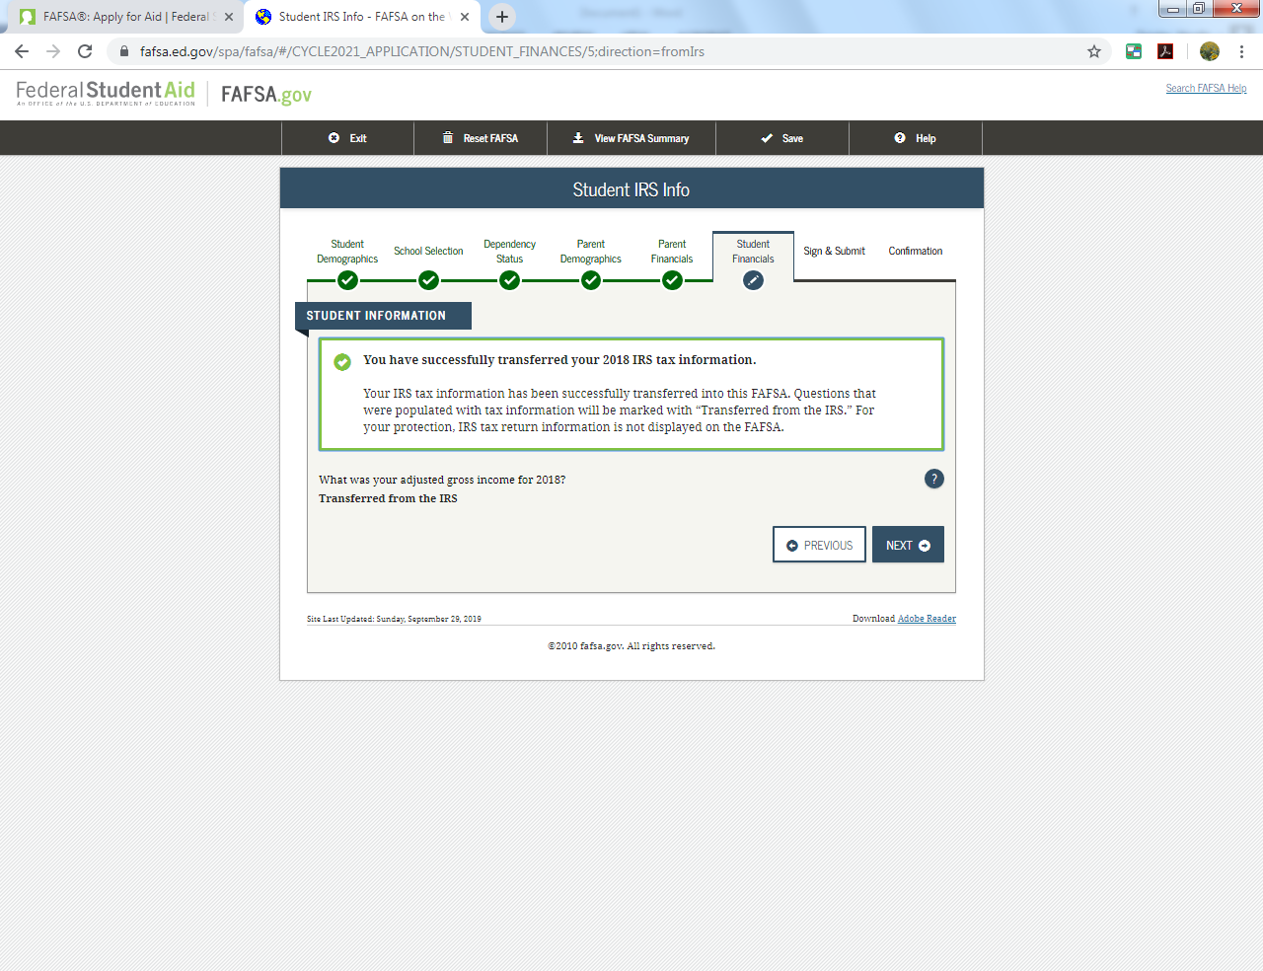

Slide 27
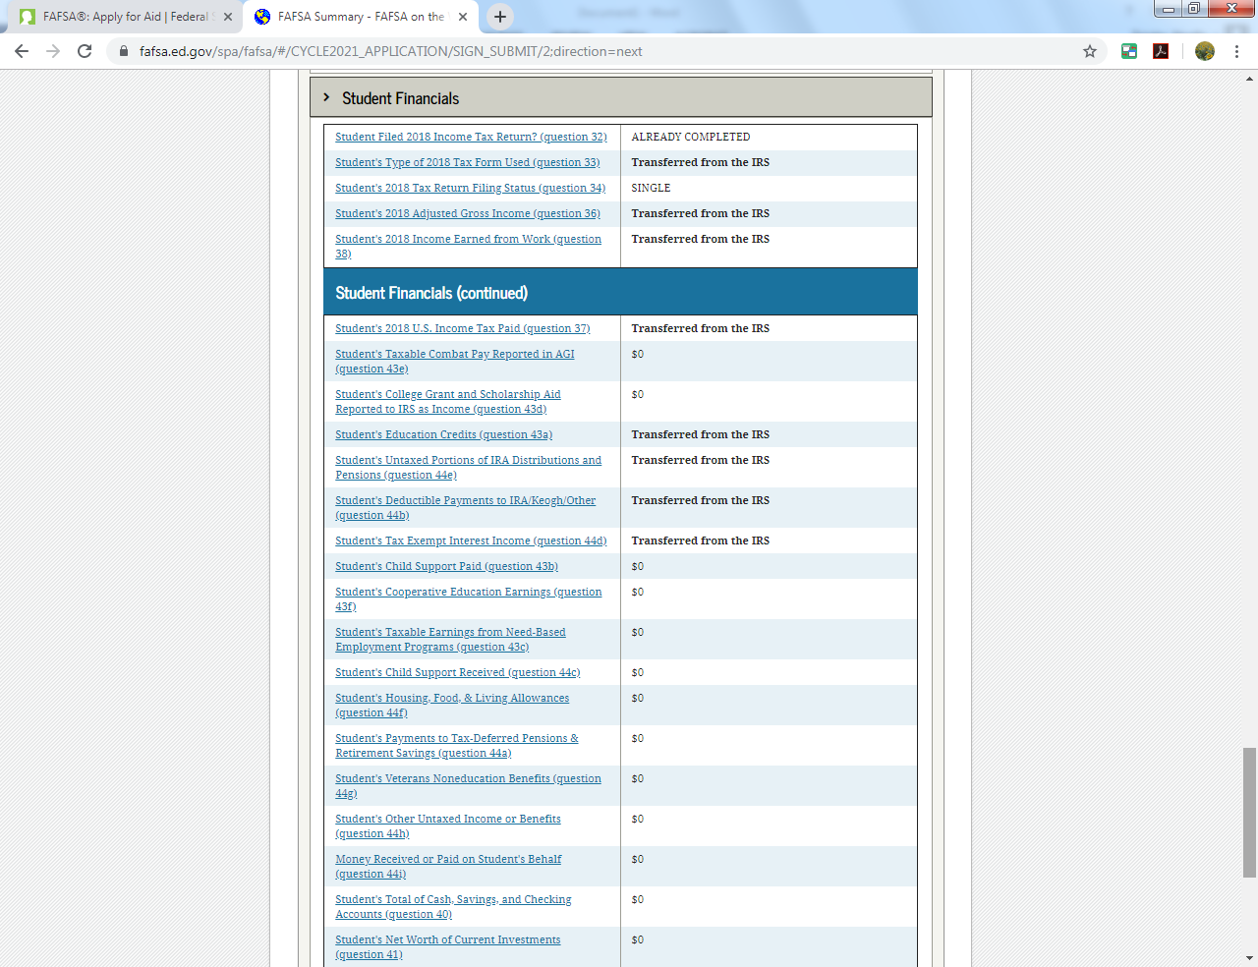

Slide 28
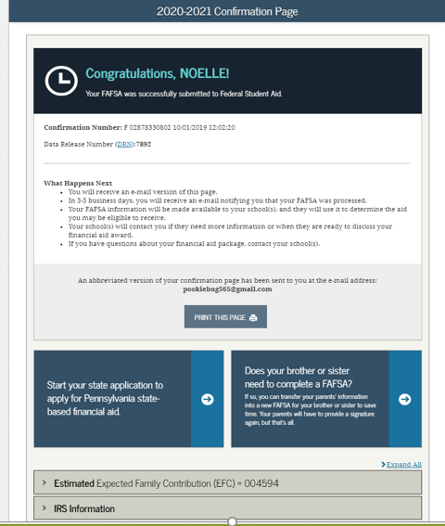
Notes:
POP UP BLOCKER

Slide 29
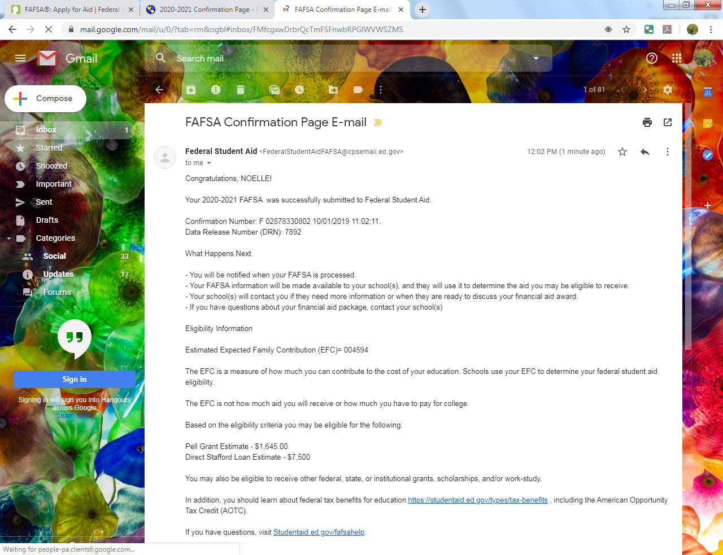

Slide 30
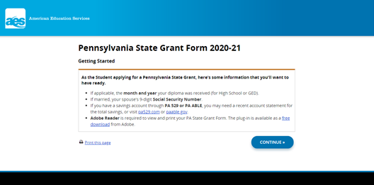

Slide 31
PHEAA State Grant
Complete the questions on each page of the PHEAA site
NEW: Will be signed via the FSA ID and Password used to complete the FAFSA
If you do this in year one and the FAFSA continues to be filed with same parent each year, you will not need to complete the state grant form again
FAFSA must be filed no later than May 1st each year

Slide 32
Verification of FAFSA
Federal government randomly flags records for further review called VERIFICATION
Each school has individual process
Must comply with verification at each school for aid to be processed
Most will ask for household verification and taxes
The IRS link on the FAFSA alleviates need for paper tax returns
PHEAA randomly flags records for further review called INCOME VALIDATION
PHEAA will email the student, the parent and will mail a letter to the home address that was listed on the FAFSA to request paperwork

Slide 33
FAFSA Funding – Federal Grant
PELL Grant
Free money from the federal government to assist the highest need students
Maximum EFC for 19/20 award year – 5576
Maximum PELL grant award for zero EFC = $6195

Slide 34
FAFSA Funding – State Grant
PHEAA State Grant
Must be PA resident, attending any accredited college in PA
Must graduate from PA Accredited High School
Determined by PA State
FAFSA must be filed by May 1st; SG application mailed
EFC of 12,000 or less
Maximum award for 19/20 - $3508

Slide 35
FAFSA Funding – Institutional Aid
Money allotted to each school by federal government – once funding is depleted, it’s gone
Federal Work Study
Working on campus for a paycheck
Does not assist with the bill (at SHIP)
FSEOG
Federal Supplemental Educational Opportunity Grant
Normally given to highest need students, PELL eligible
Maximum award for 19/20 at SHIP - $500
Perkins Loans
Funding was not renewed by Federal Government for future awards

Slide 36
FAFSA Funding – Student Loans
Subsidized Student Loans (Stafford)
Funded by US Department of Education
Based on ‘need’
Accrues NO INTEREST while in school
Payment plan begins 6 months after graduation (or dropping below half time or not returning)
Loan has a 1.059% origination fee taken prior to the loan being paid to the University

Slide 37
FAFSA Funding – Student Loans
Unsubsidized Student Loans (Stafford)
Funded by US Department of Education
Not based on ‘need’ – any student can receive
Interest accrues for life of loan from first disbursement
Current interest rate: 4.53%
Payment plan begins 6 months after graduation (or dropping below half time or not returning)
Loan has a 1.059% origination fee taken prior to the loan being paid to the University

Slide 38
More Funding Options
Parent PLUS Loans (Must file FAFSA)
Loan PARENT can take out on behalf of student
Based on parent’s credit
Solely in parent’s name, can never be put in student’s
Can apply after April 15th online
If approved, can cover whatever amount is needed
Repayment can begin while student is in school, upon graduation or 6 months after graduation
Interest rate is currently 7.08%
Loan has 4.236% origination fee taken prior to being paid to the University
www.studentloans.gov

Slide 39
More Funding Options
Alternative Student Loans (Credit Based, Educational Loans)
Normally in student’s name (as long as 18)
Normally require a credit worthy co-signer
Interest rates can be variable
Origination Fees
Private bank, credit union, list of lenders on website

Slide 40
FAFSA Funding - Academics
Qualifying for federal or state aid is based on satisfactory academic progress
Federal Aid – Grants, FWS, Student Loans, Parent Loans
2.0 Cumulative GPA
67% pace completion
Must complete 67% of classes attempted
PHEAA
24 NEW credits each year

Slide 41
FAFSA Funding - Academics
Annual Federal Loan Limits
1st year, Freshman (less than 30 credits) = $5500
2nd year, Sophomore (30 – 59 credits) = $6500
3rd year, Junior (60 – 89 credits) = $7500
4th year, Senior (90+ credits) = $7500

Slide 42
Reality
If your child excels academically, they may get academic scholarships
If your child excels athletically, they may get athletic scholarships
If your income and household size shows a ‘need’, they may get free money in the form of grants
No child, regardless of race, creed or nationality gets a ‘free ride’ for that reason
If you are a middle income family – making about $110,000 or more, you will most likely be funding the education with payments and loans

Slide 43
What to do RIGHT NOW!!!
File the 20/21 FAFSA at www.fafsa.gov TODAY
APPLY FOR SCHOLARSHIPS!!!
Check with your guidance office
Your local community
Your employer
Parent’s and grandparent’s employers
Online resources
PHEAA – www.aessuccess.org w.aessuccess.org
FASTWEB – www.fastweb.com

Slide 44
Things to look out for…
Financial Aid Shopping Sheet
Not all schools participate
Meant to be the same at each school for easier comparison
Net Price
Each school has Net Price Calculator on website
Determines the amount you will have to come up with to go to that university

Slide 45
Example
School A:
Private, out of state University
Tuition and Fees cost $40,000 a year
University awards child $20,000 scholarship
Net price = $20,000
School B:
Public, in state University (like SHIP ☺)
Tuition and fees cost $13,000 a year
University awards child $2,000 scholarship
Net price = $11,000

Slide 46
Things to look out for…
Don’t pay for free money
If they want you to pay, run away
If it’s too good to be a true, it normally is
Buyer beware
Social Security Numbers
Scams

Slide 47
Reminders!!
File early
Check often
TEAM EFFORT

Slide 48
QUESTIONS????
Rachel Richards
Associate Director of Financial Aid
Shippensburg University
717-477-1123 ext. 3012
717-477-1131
rdrichards@ship.edu
finaid@ship.edu

